Slide 1

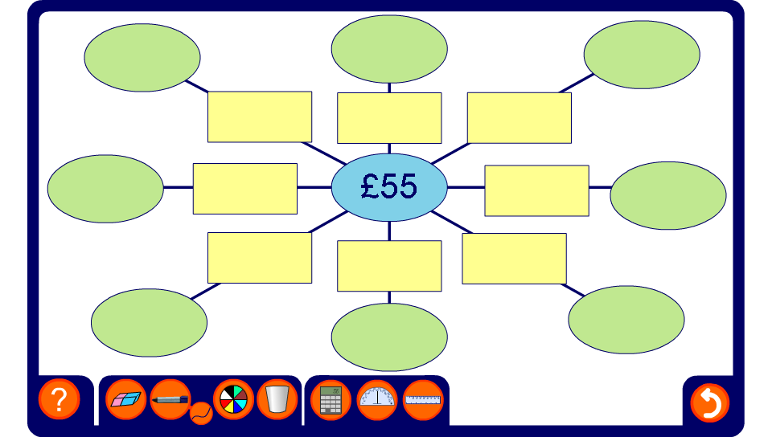


Calculating percentages
Notes:
Ask pupils to calculate the given percentages of the central amount using an appropriate written or calculator method.
Make the activity more challenging by revealing the proportion and asking what percentage of the central amount it represents.

